Slide 1

SRI MANAKULA VINAYAGAR ENGINEERING COLLEGE (An Autonomous Institution)
Department of Electronics and Communication Engineering
Hybrid Metaheuristic Approach for NLoS Vehicle Localization to Enhance Emergency Message Propagation in VANETs
Presented by:
Sri Rajadurai S (21UEC181),
Pranav R (21UEC134),
Kadali Prasanth Kumar (21ECL006)
Guided by:
Dr. SB. Lenin
Associate Professor
Department of ECE

Slide 2
Outline of the Presentation
Introduction
Problem Statement
Objectives
Literature Survey
Existing System
Proposed System
Workflow
Implementation
Results and Analysis
Outcome
References

Slide 3
Introduction
Wireless Sensor Networks (WSNs) enable effective communication in Vehicular Ad Hoc Networks (VANETs).
Urban environments pose challenges due to high mobility and Non-Line-of-Sight (NLOS) conditions.
Adaptive algorithms can improve localization accuracy and network reliability.

Slide 4

Problem Statement
Accurate vehicle localization is difficult in NLOS urban areas due to obstructions.
Poor localization leads to high latency in emergency message delivery.

Slide 5
Objective
Ensures reliable communication Under NLOS conditions.
Improve emergency message routing using optimized localization data.
Enhance energy efficiency and communication reliability in NLOS scenarios.

Slide 6
Literature Survey
Title | Author | Remarks
Spotted Hyena Optimization and Simulated Annealing-Based NLOS Nodes Localization Scheme for Improving Warning Message Dissemination in VANETs | S. B. Lenin and N. Tamilarasan | Difficulty in tuning multiple new parameters for optimal performance Potential scalability issues in very large vehicular networks
Enhanced Ant Colony Optimization for Vehicular Ad Hoc Networks Using Fittest Node Clustering | Akhilesh Bijalwan, Iqram Hussain, Kamlesh | Complexity of implementing multiple new features like node clustering Possible over-reliance on heuristics, which may not guarantee optimal solutions
Adaptive Ant Colony Optimization with Node Clustering for the Multi-depot Vehicle Routing Problem | Petr Stodola and Jan Nohel | Large-scale multi-depot vehicle routing problems in logistics and military operations
An Ant Colony Optimization-Simulated Annealing Algorithm for Solving a Multiload AGVs Workshop Scheduling Problem with Limited Buffer Capacity | Zishi Wang and Yaohua Wu | Complex implementation MLAGV workshop scheduling with limited buffer capacity
Data Transmission in Wireless Sensor Networks Based on Ant Colony Optimization Technique | Lin Wu, Ahmad Yahya Dawod and FangMiao, | Efficient clustering in VANETs for improved network stability and reduced packet delays in dense traffic environments

Slide 7
Literature Survey (Cont.)
Hybrid metaheuristic methods (e.g., ACO + SA) improve optimization performance.
Prior research has applied various techniques such as SHO, GWO, and ROA for VANET localization.
This work proposes a refined approach combining ACO's exploration with SA's local search refinement.

Slide 8
Abstract
The proposed method improves emergency message propagation efficiency in VANETs by enhancing localization accuracy and minimizing latency. To achieve this, a hybrid Ant Colony Optimization-Simulated Annealing (ACO-SA) localization algorithm is developed specifically for urban environments.

Slide 9
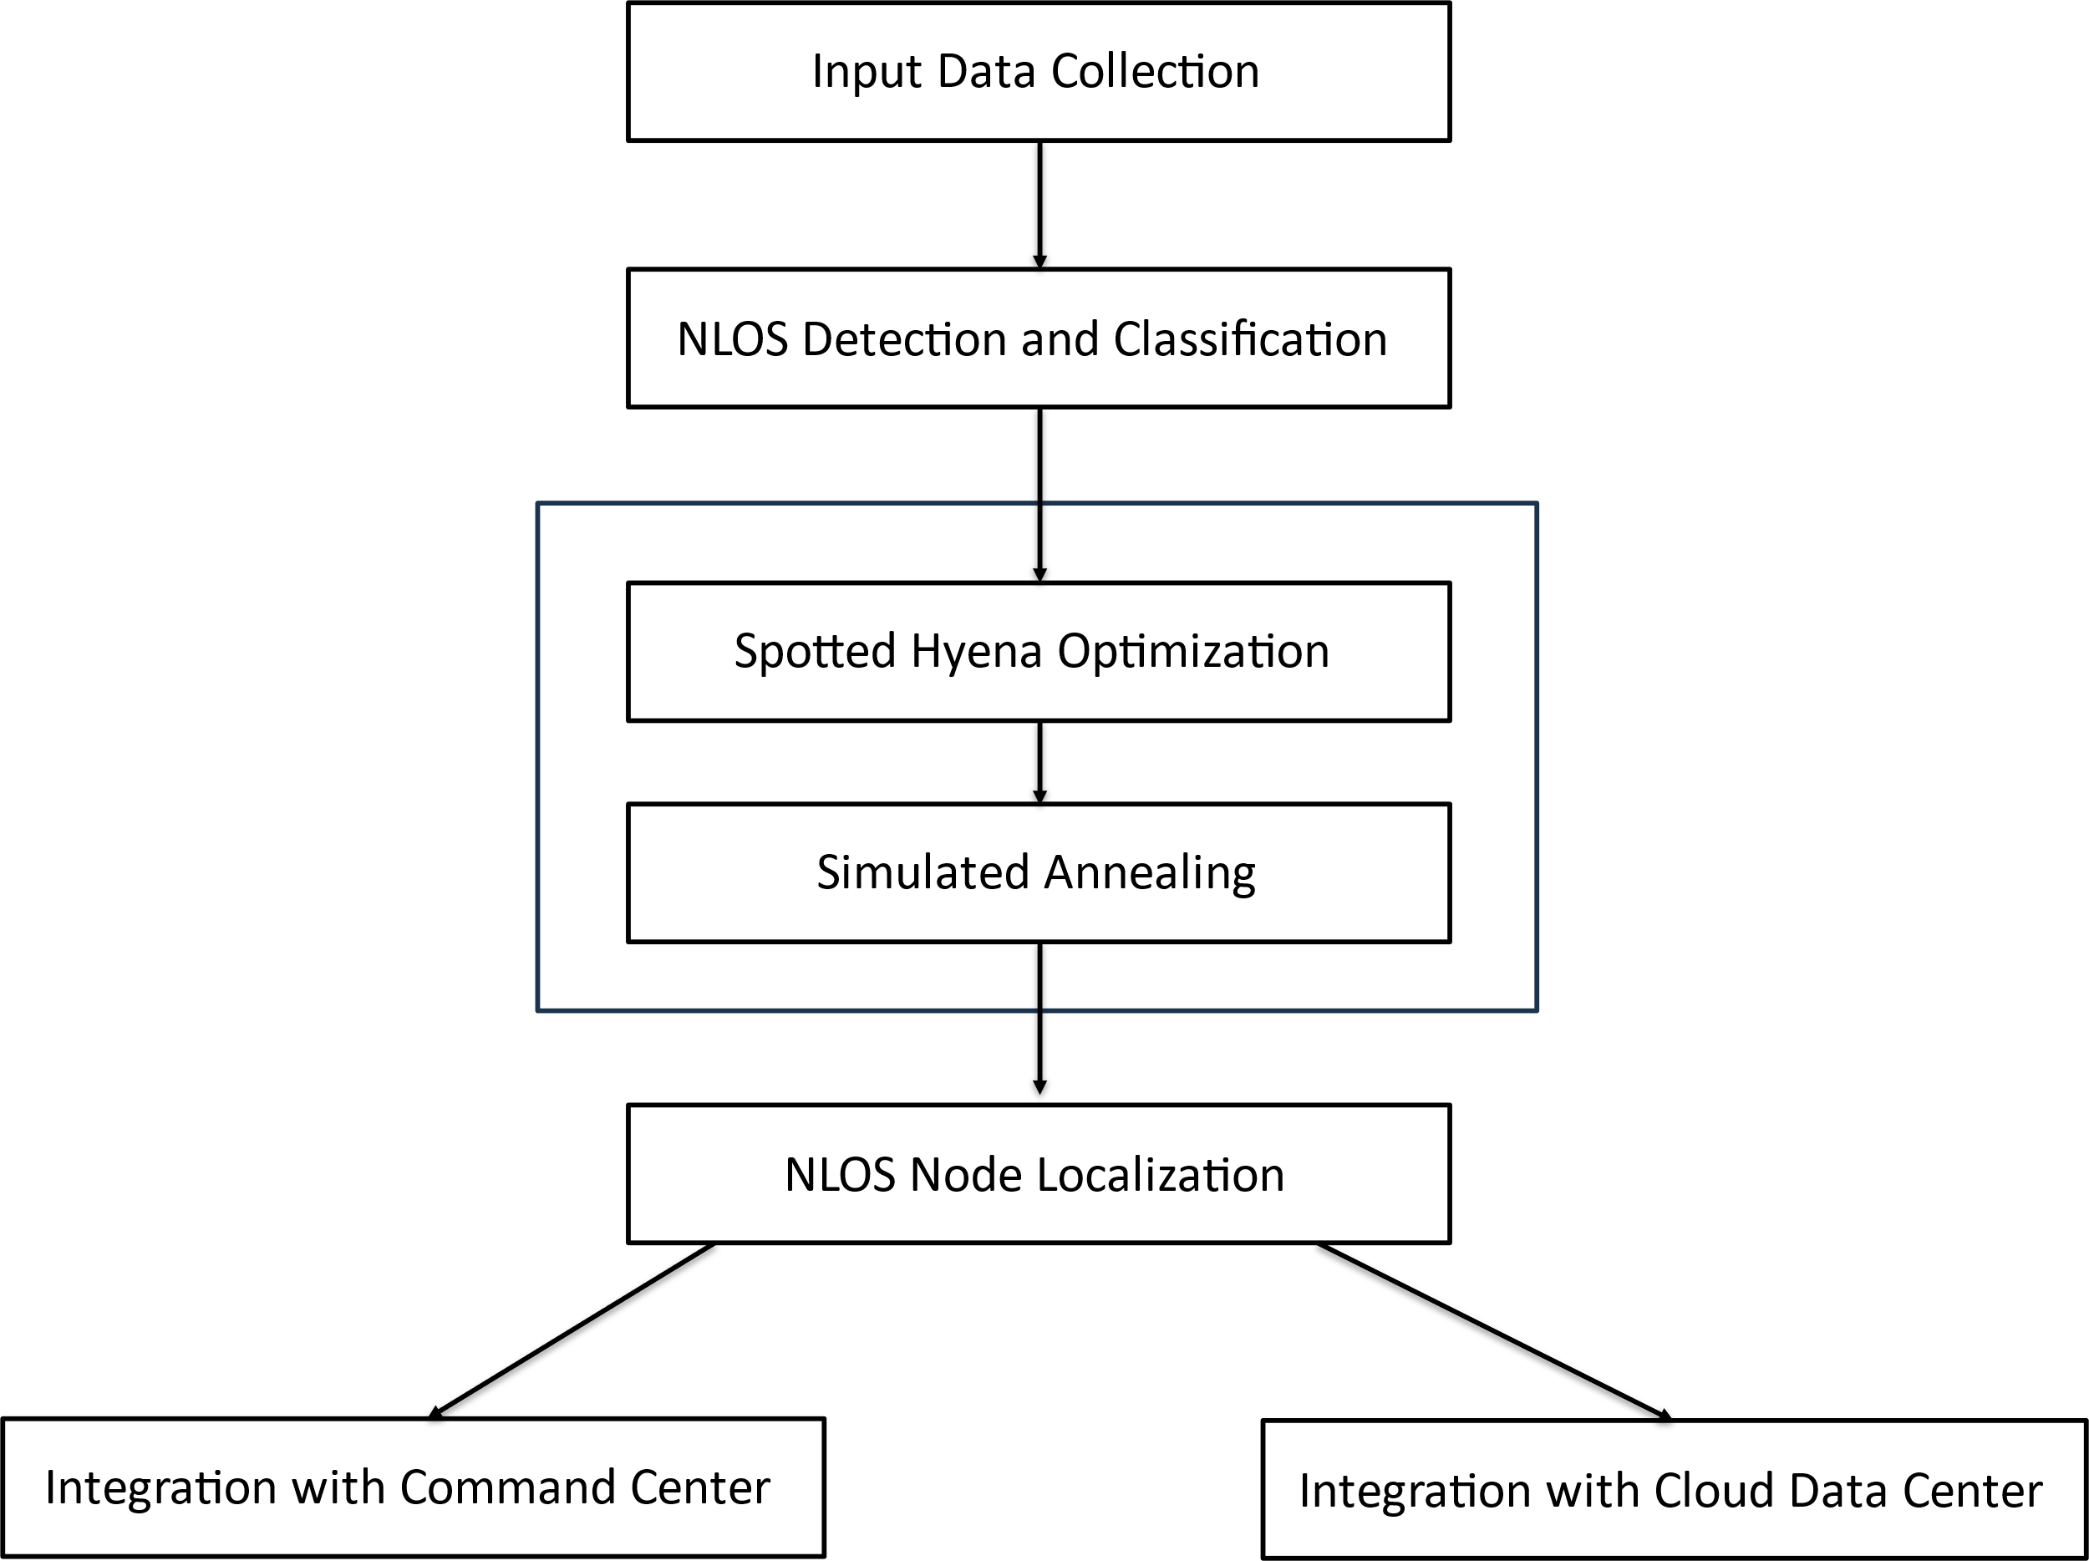
Existing System

Slide 10
Cont.
Data Collection: Real-time vehicle data to identify LOS/NLOS conditions.
Position Estimation: Uses SHO and SA for initial localization.
Monitoring: Data is integrated with a centralized cloud system.
Limitations: May suffer from local optima and less dynamic adaptability

Slide 11
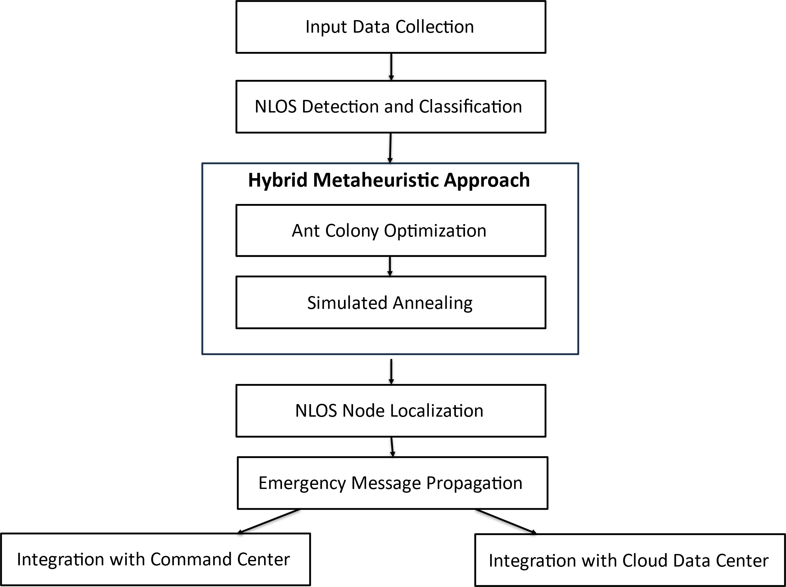
Proposed System

Slide 12
Cont.
Hybrid Algorithm: Combines ACO (exploration) and SA (exploitation).
Localization: More precise vehicle positioning under NLOS.
Emergency Routing: Improved dissemination of emergency messages.
Integration: Real-time monitoring via cloud/command centers.

Slide 13
Workflow of the project
Understanding existing methodologies
Identify strengths and limitations of the methodologies
Defining the design requirements and constraints
Developing the hybrid algorithm for vehicle localization
Optimization of the simulated results
Simulation and Validation
Model the hybrid ACO-SA algorithm in simulation tool
Implementation the optimized model
Testing and Validation
Performance Analysis

Slide 14
Implementation
Algorithm Selection: ACO and SA chosen for their complementary strengths.
Hybrid Integration: Enhances robustness and convergence.
Coding Framework: Developed simulation in a suitable platform

Slide 15
Implementation Results

Slide 16
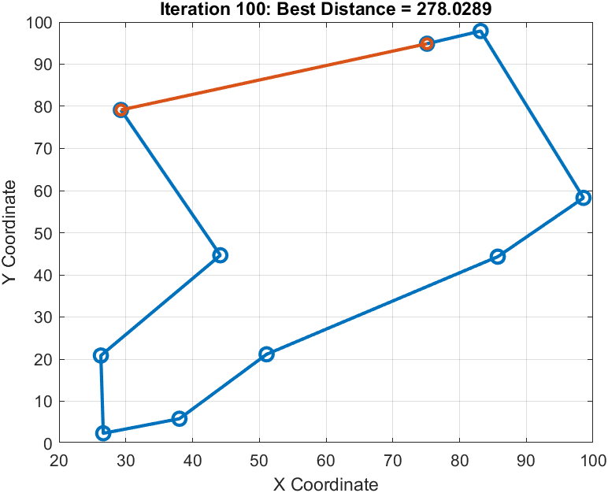
Optimal Path Identification:
ACO locates shortest path; SA reduces node revisit, lowering latency.

Slide 17
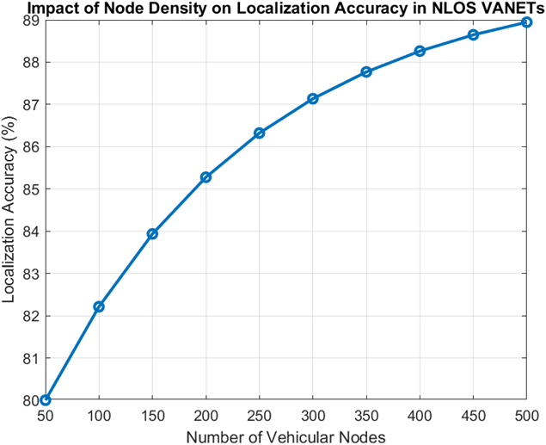
Localization Accuracy vs. Node Density
Accuracy improves with density up to ~300 nodes.

Slide 18
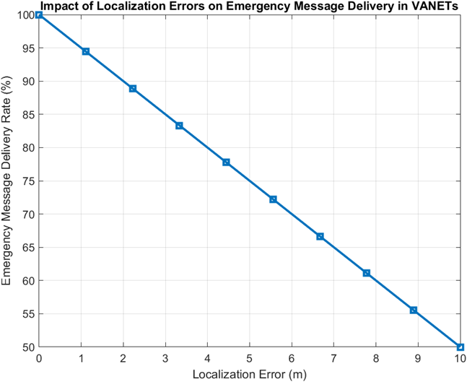
Localization Error vs. Emergency Message Delivery Rate
As error increases, delivery rate decreases.

Slide 19
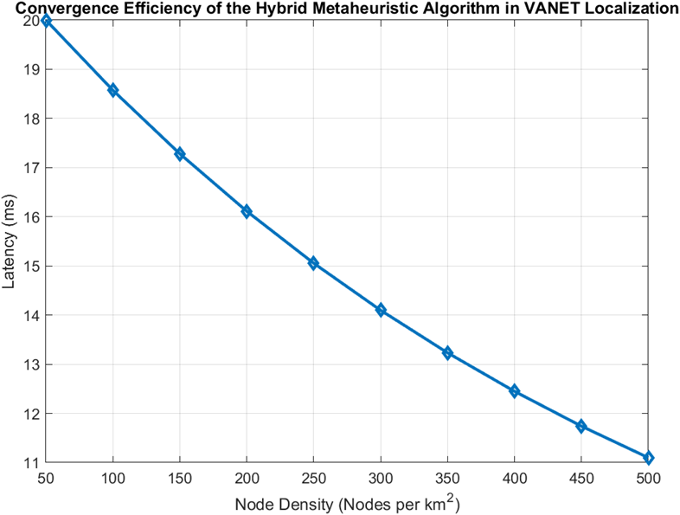
Node Density vs. Emergency Message Latency
Higher density reduces message latency.

Slide 20
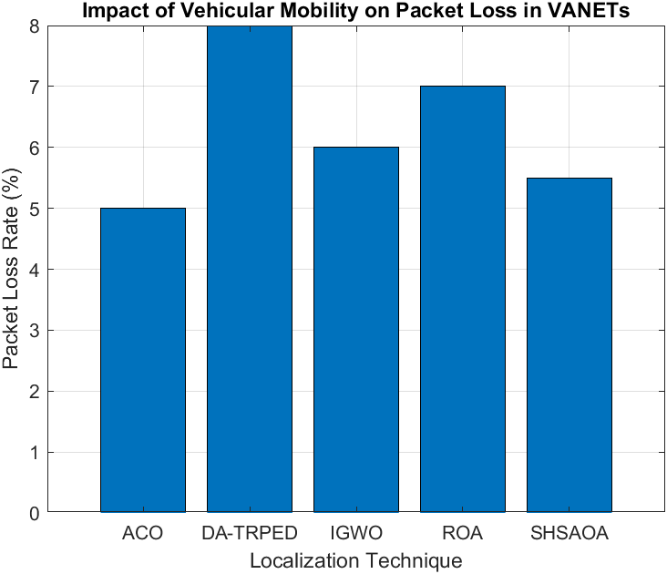
Packet Loss Rate in Different Localization Methods
SHSAOA has higher loss; ACO adapts better, suggesting hybrid superiority.

Slide 21
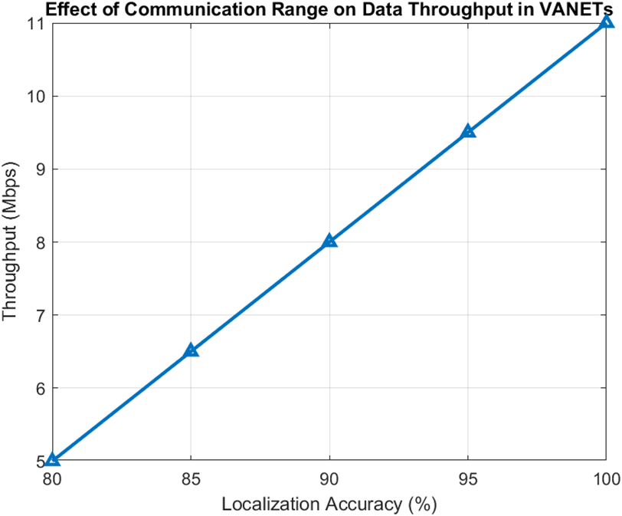
Localization Accuracy vs Network Throughput
Increased accuracy leads to better throughput (up to 11 Mbps).

Slide 22
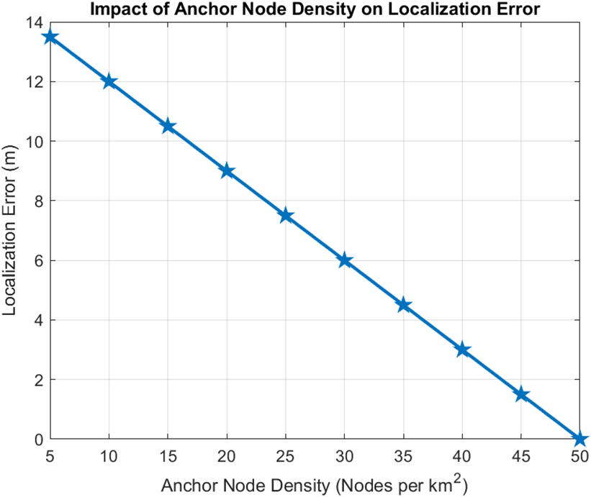
Anchor Node Density on Localization Accuracy
More anchors = higher localization precision.

Slide 23
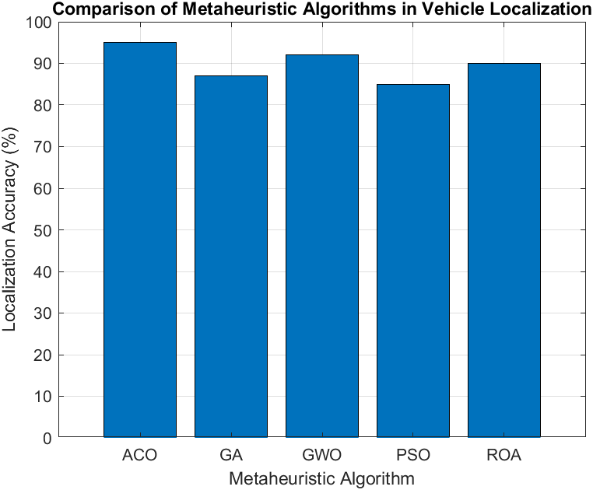
Analysis of Metaheuristic Algorithms in VANET Localization
ACO > GWO > ROA > GA > PSO in localization performance.

Slide 24
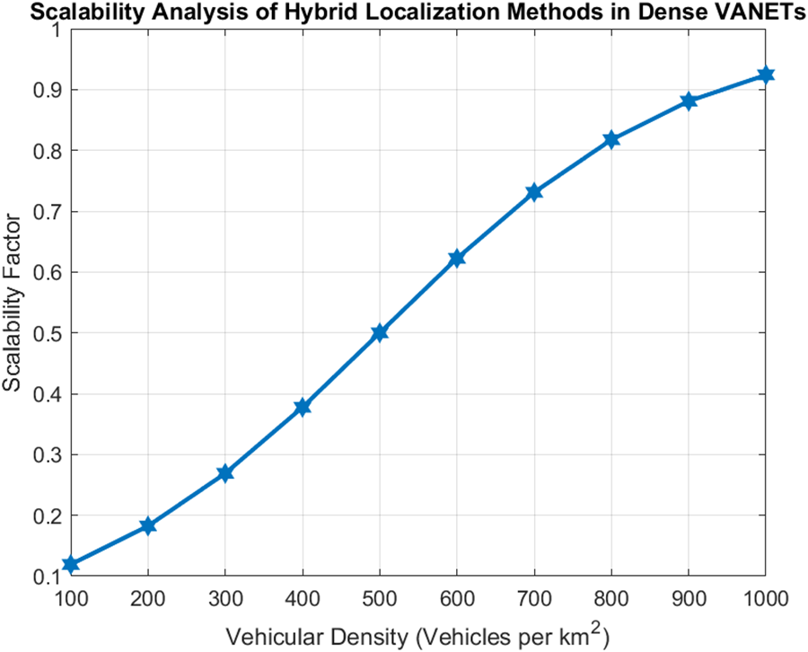
Scalability of Hybrid Localization in Dense VANETs
Hybrid model maintains performance with rising node density

Slide 25
Outcome
Faster Localization & Routing: Critical for emergencies.
Lower Energy Consumption: Optimized routing paths reduce load.
Improved Communication Paths: Finds shortest, most reliable paths.
High Localization Accuracy: Effective even with urban obstructions

Slide 26
References
S. B. Lenin and N. Tamilarasan, "Spotted Hyena Optimization and Simulated Annealing-Based NLOS Nodes Localization Scheme for Improving Warning Message Dissemination in VANETs," International Journal of Ad Hoc and Ubiquitous Computing, Vol. 34, No. 3, pp. 1-15, Sep. 2022, DOI: 10.1007/s11277-022-09961-y.
Akhilesh Bijalwan, Iqram Hussain, Kamlesh Chandra Purohit and M. AnandKumar, “Enhanced Ant Colony Optimization for Vehicular Ad Hoc Networks Using Fittest Node Clustering” Sustainability 15(22), Nov. 2023, DOI: 10.3390/su152215903.

Slide 27
Other key references on ACO, SA, and VANET optimization
Petr Stodola and Jan Nohel, ”Adaptive Ant Colony Optimization with Node Clustering for the Multi-depot Vehicle Routing Problem” IEEE Transactions on Evolutionary Computation, Vol. 27, No. 6, Dec. 2023, DOI: 10.1109/TEVC.2022.3230042.
Zishi Wang and Yaohua Wu, ”An Ant Colony Optimization-Simulated Annealing Algorithm for Solving a Multiload AGVs Workshop Scheduling Problem with Limited Buffer Capacity”, Processes 11(3): 861, March 2023, DOI: 10.3390/pr11030861.
Lin Wu, Ahmad Yahya Dawod and FangMiao, ”Data Transmission in Wireless Sensor Networks Based on Ant Colony Optimization Technique”, Applied Sciences 14(12): 5273, June 2024, DOI: 10.3390/app14125273.

Slide 28
THANK YOU

